Slide 1

Super Duper Bowling

Slide 2
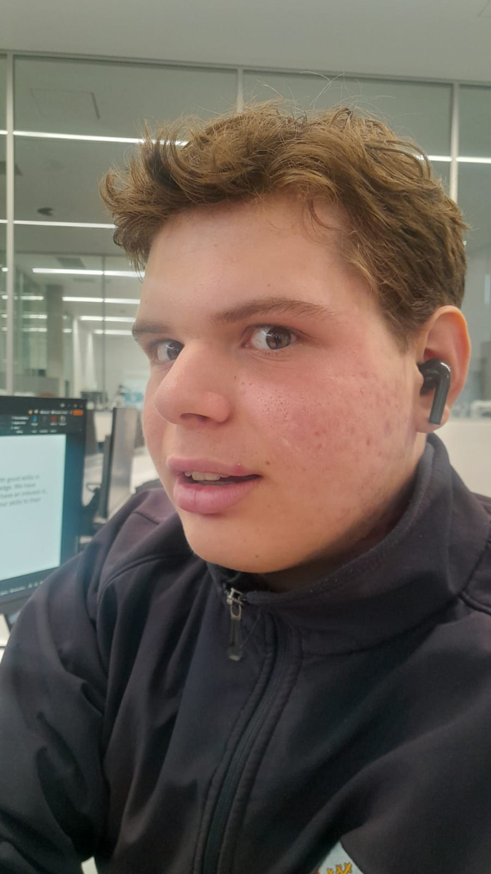
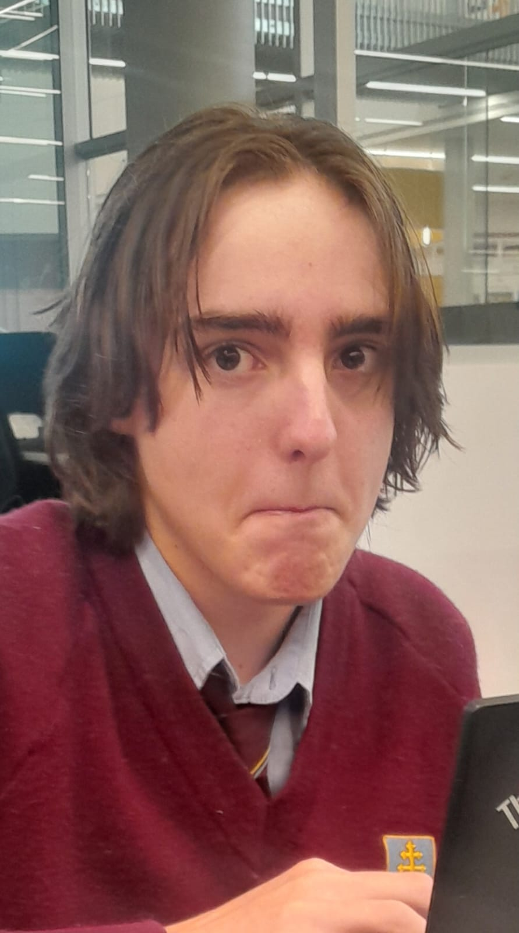
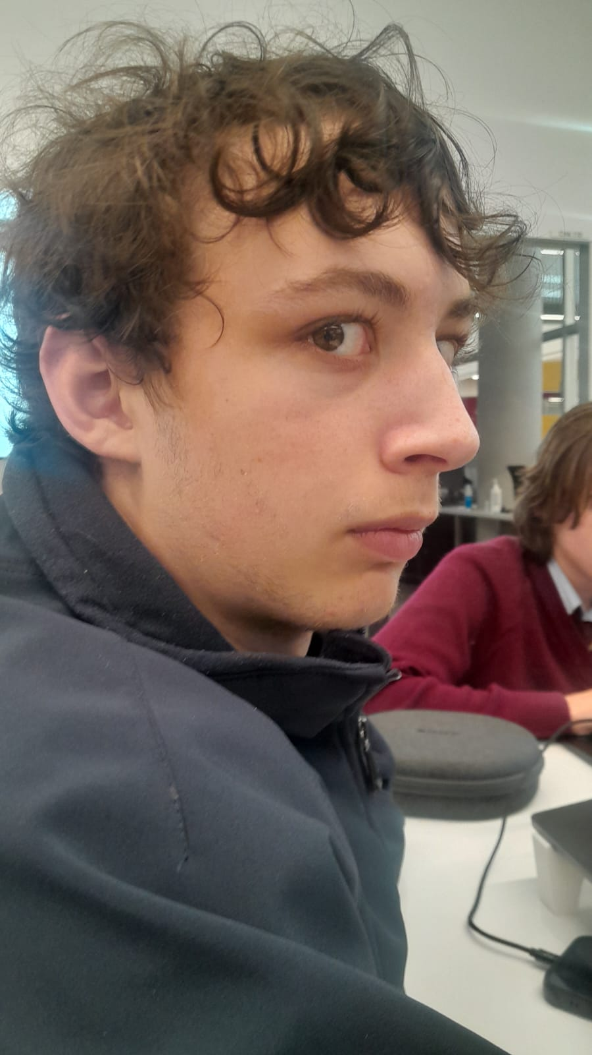
The Team
Our team is well balanced, including people with good skills in coding, UI, art, and any other necessary knowledge. We have designed the game to be something that we all have an interest in, so that it’s easier for us to collaborate and use our skills to their fullest potential.
Max
Menus, UI, Voice Acting, Tutorials
Eddison
Textures, Music, Level Design, Sound, Art
Brodie
Programming, Testing, Bug Fixes

Slide 3
Capabilities
The three of us have a very wide range of abilities, which will allow us to complete the game to a satisfactory standard before the end of the year.
Coding (Brodie): I understand that parkour is a difficult mechanic to implement, but I know that given time (more than enough time is available) I can implement a smooth and intentionally quirky movement system that will fit the game well.
Art, Sound & Design (Eddison):
UI, Tutorials, Voice Acting & Extras (Max): I can learn things quickly and I am generally an all-round “fill in the gaps” team member who will do the things that the rest of my team doesn’t specialize in.

Slide 4
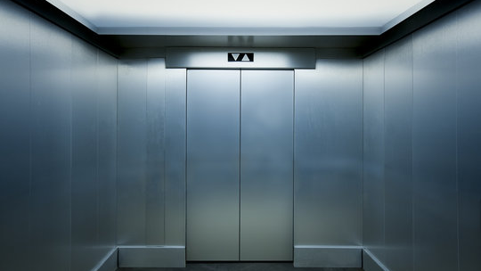
Elevator Pitch
Movement-based precision game with a focus on having control of a character in attempts to knock enemies off a platform.

Slide 5

Overview
Genre: Platformer
Audience: Teenagers
Topic: Parkour / Bowling
Style: Futuristic Arena

Slide 6
Why our game is better than others
Smooth Movement and fast-paced gameplay.
USP: Parkour based movement with a low entry point and a high skill ceiling.
Similar to successful games – such as Karlson, Neon White, and Cluster Truck – Super Duper Bowling will have fluid and intuitive movement mechanics.
A unique win condition that differentiates our game and makes it one of a kind.

Slide 7
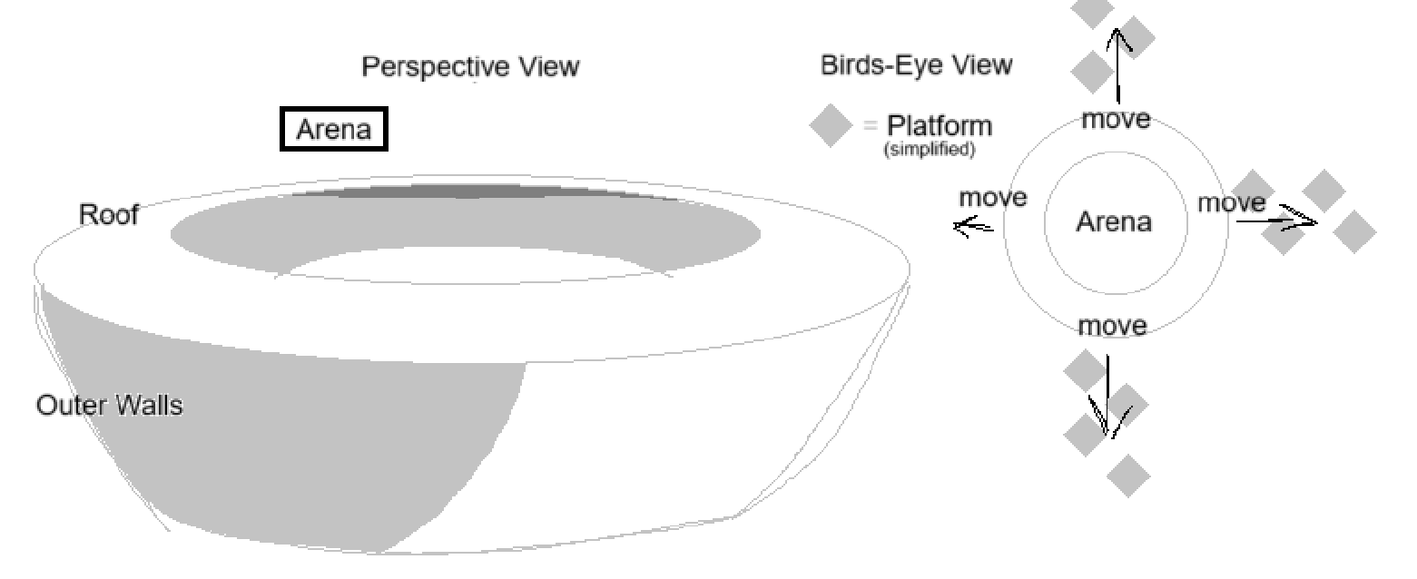
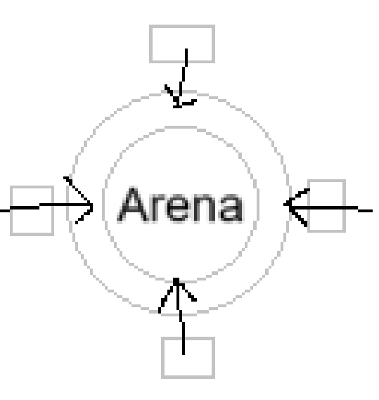
Level Design: Overview
The game will take place in an arena with multiple moving, floating platforms the player must jump between to stay in the arena.
Initially the arena was going to move around static platforms to create the illusion of movement, but to have multiple platforms moving in different directions at once, the platforms themselves will have to move.

Slide 8
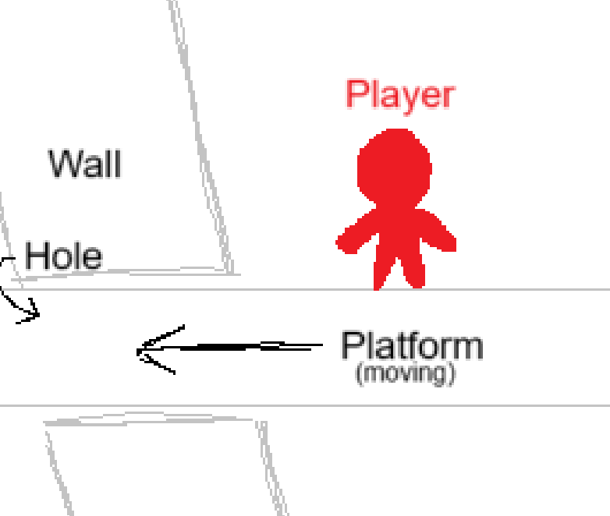
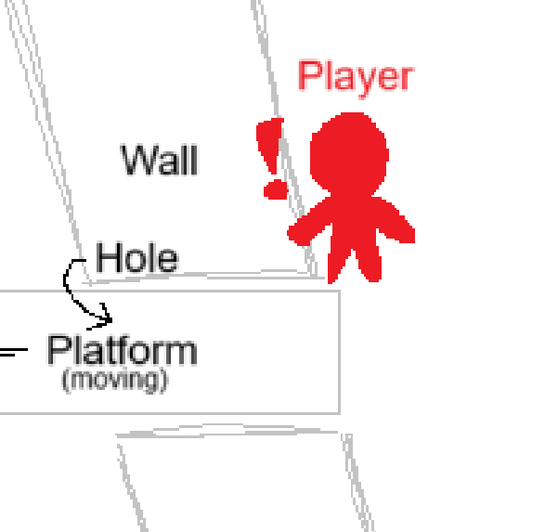
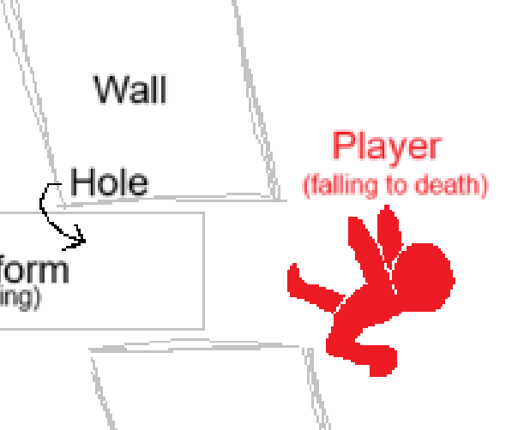
Game Mechanics: Forced Parkour
To help achieve the fast-paced movement, action, and parkour elements that we envision for this game, we utilise platform movement to force the player to be constantly moving.
This also creates an adapting map that the player can use to their advantage, jumping from one moving platform to another, keeping the speed from the previous platform.

Slide 9
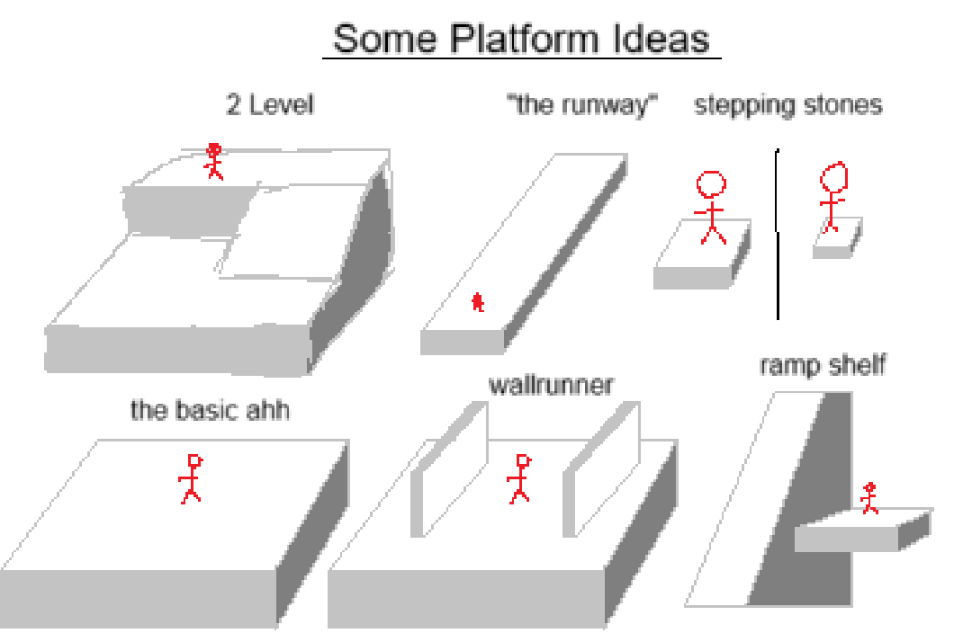
Level Design: "Mini Levels"
Each platform can be considered as "mini levels", as each one is different. Some may have enemies, some may be large, and some may simply act as stepping stones to help you get from one platform to another.

Slide 10
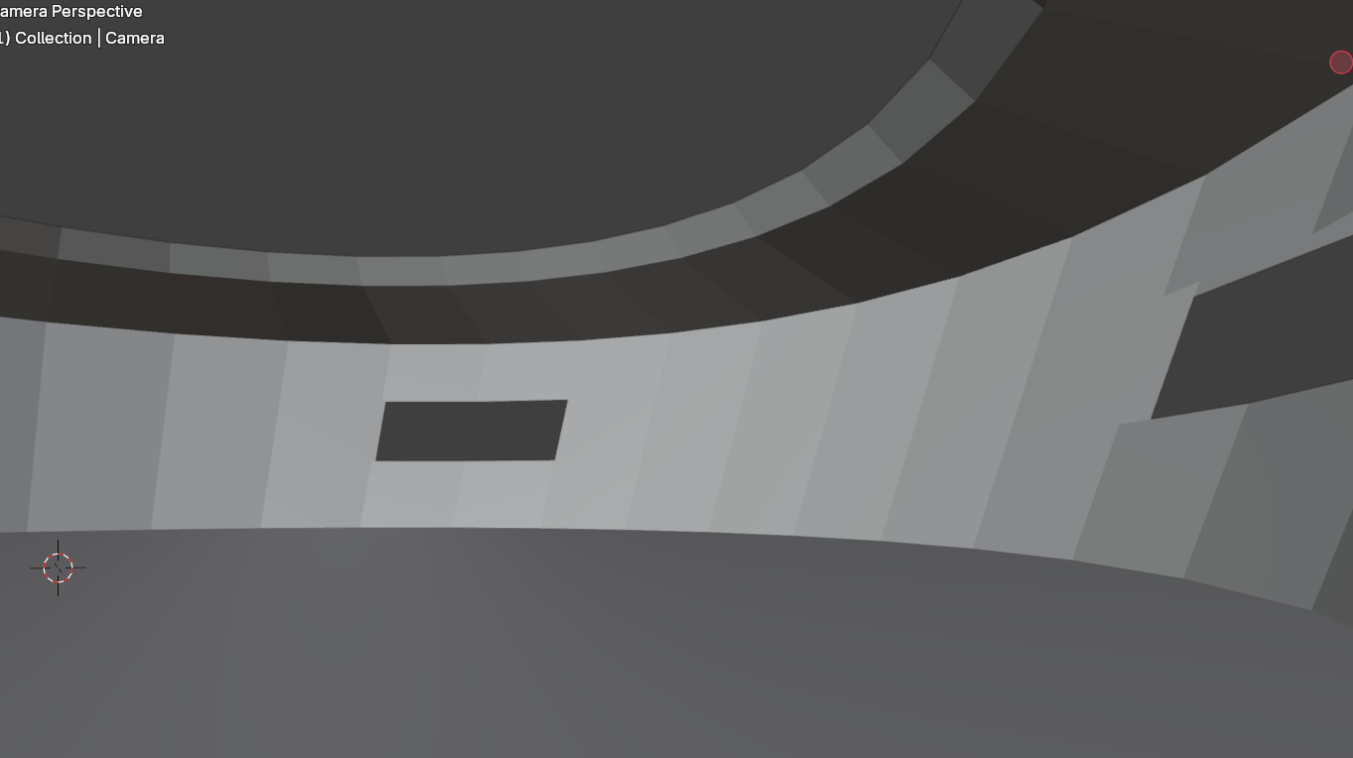
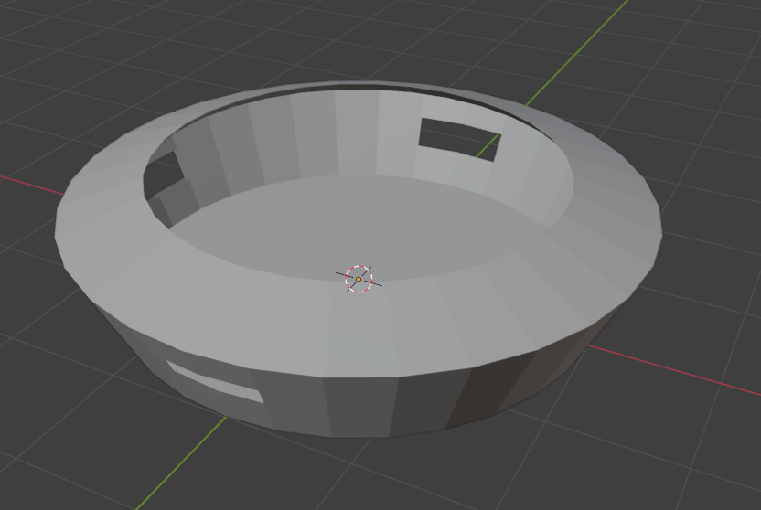
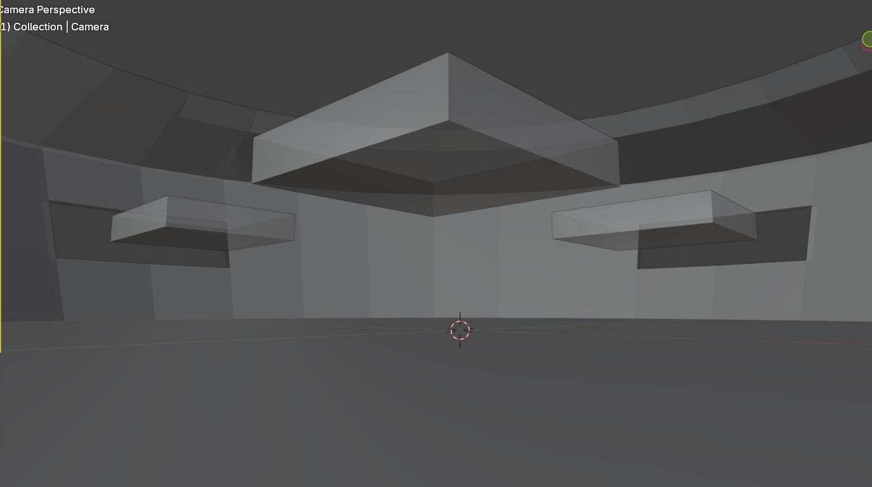
Concept Art: Arena

Slide 11
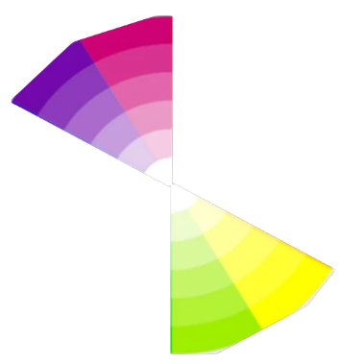
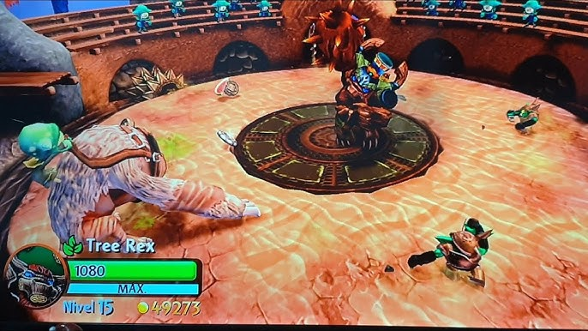
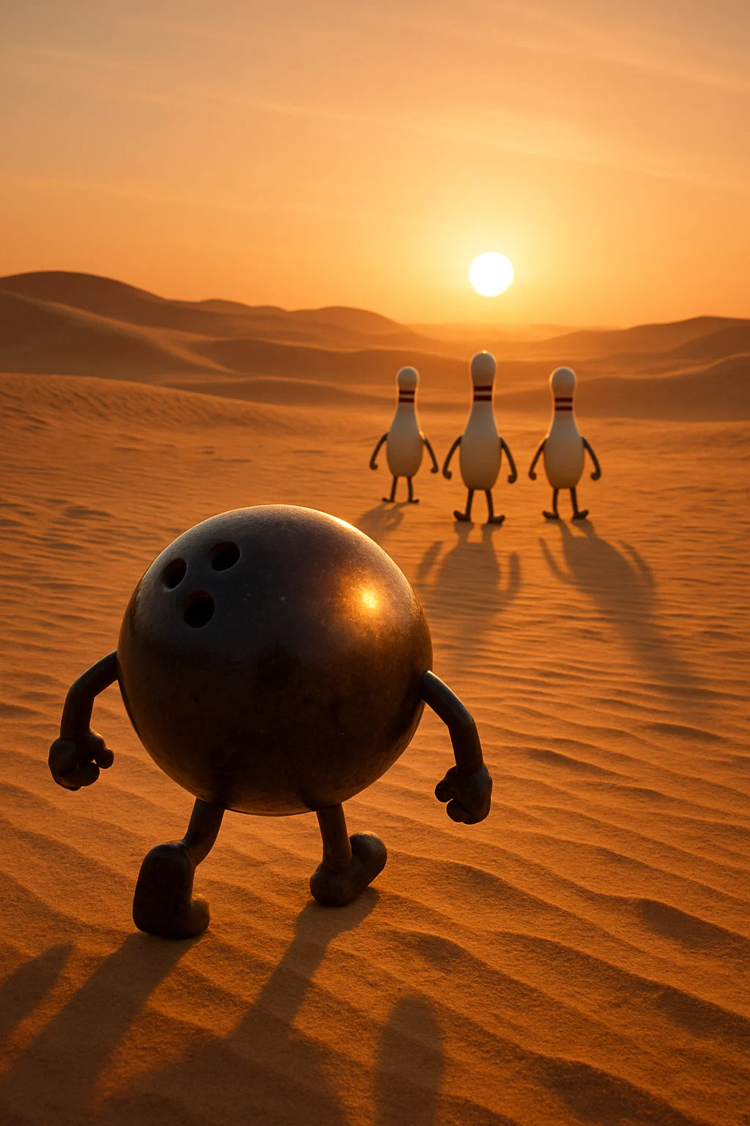
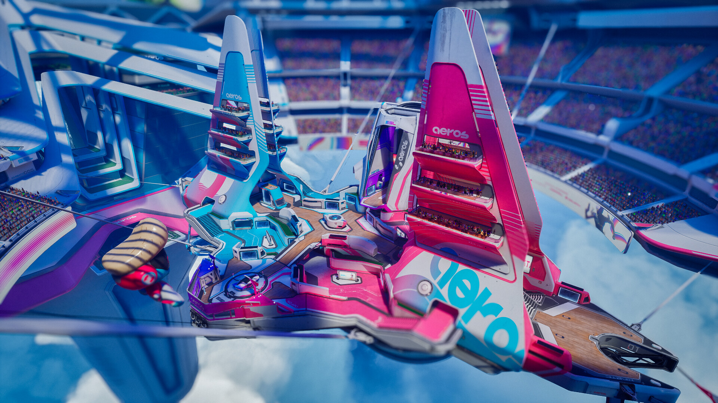
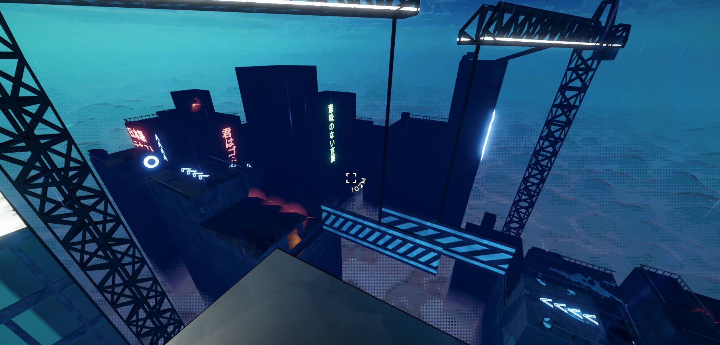
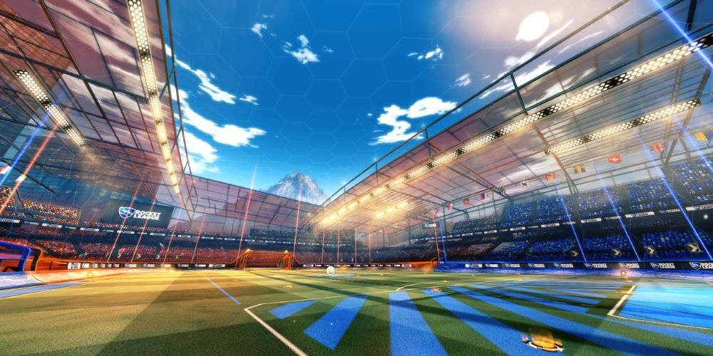
Reference Images

Slide 12

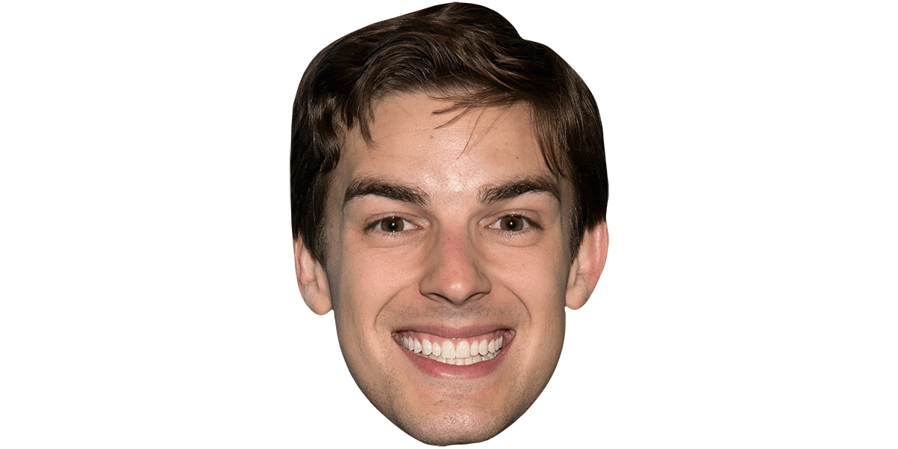
The Lore
The main character, Malcom Baller, has always been baller at Super Bowling. Eventually though, it became a professional sport, the Super Bowling Leage (SBL). Malcom decided to dominate the sport. The game follows Malcom on his journey to becoming the best, with unrelenting victory after unrelenting victory, Malcom defeats all his opponents in time, accuracy, and extreme style.
When the player completes all the levels, there will either be a "cutscene" or just a simple trophy on the home screen. It's unlikely this lore will be conveyed to the player, as it doesn’t add much to the game.

